Slide 1
Getting more contributors (and diversity) through outreach
Asheesh Laroia
PyCon 2011

Slide 2
Getting more contributors (and diversity) through outreach
Asheesh Laroia
PyCon 2011
(starting right now)

Slide 3
<1>
Me, you, and this talk

Slide 4
→

Slide 5


Slide 6


paulproteus on
asheesh@
asheesh.org

Slide 7
About you
?

Slide 8
Isolation
reinforces itself

Slide 9
<2>
Fedora Design Team outreach

Slide 10


Slide 11
Goal: attract at least one contributor every 3 months

Slide 12


Slide 13
invited

Slide 14
clear and urgent

Slide 15
offer help

Slide 16
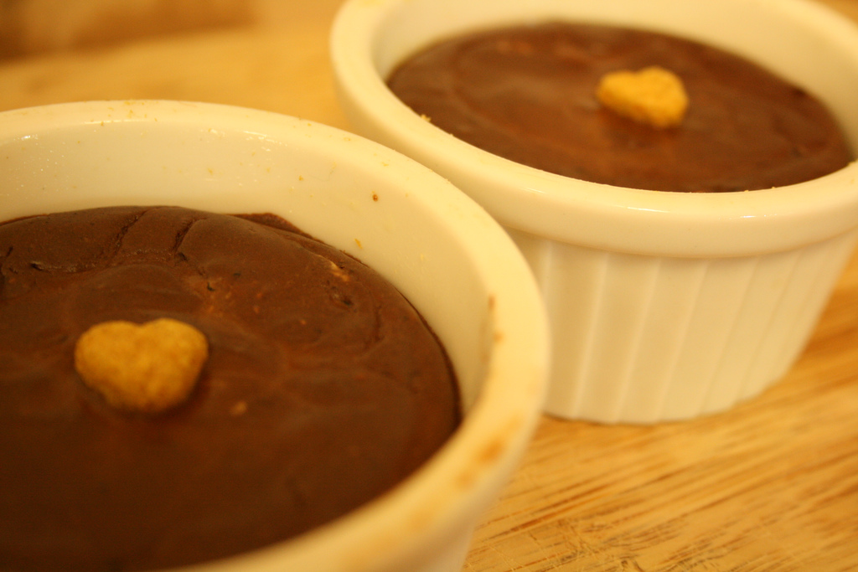

Slide 17


Slide 18


Slide 19
?

Slide 20
!

Slide 21
<3>
SF Rails Workshops

Slide 22
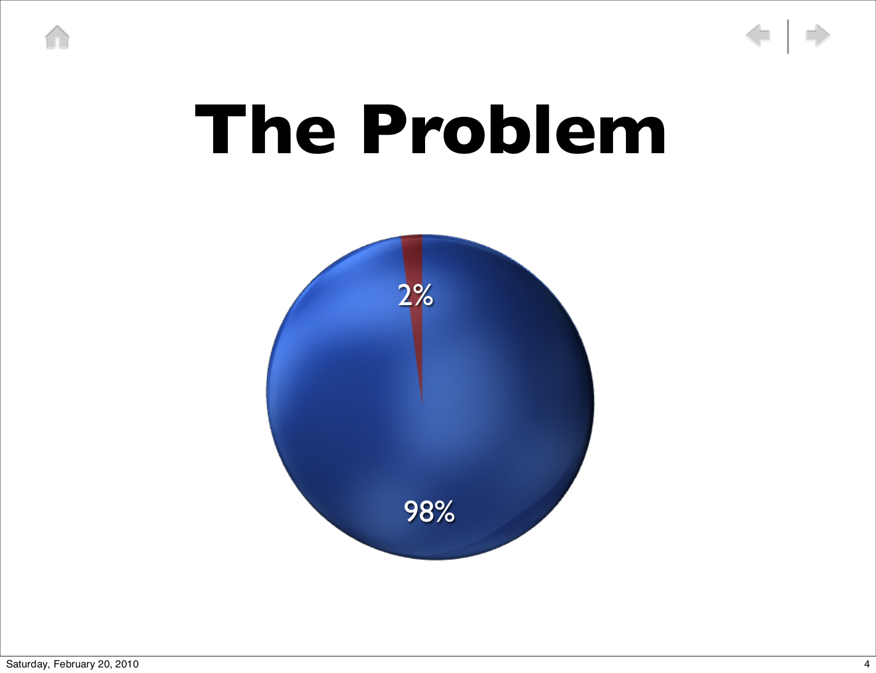

Slide 23
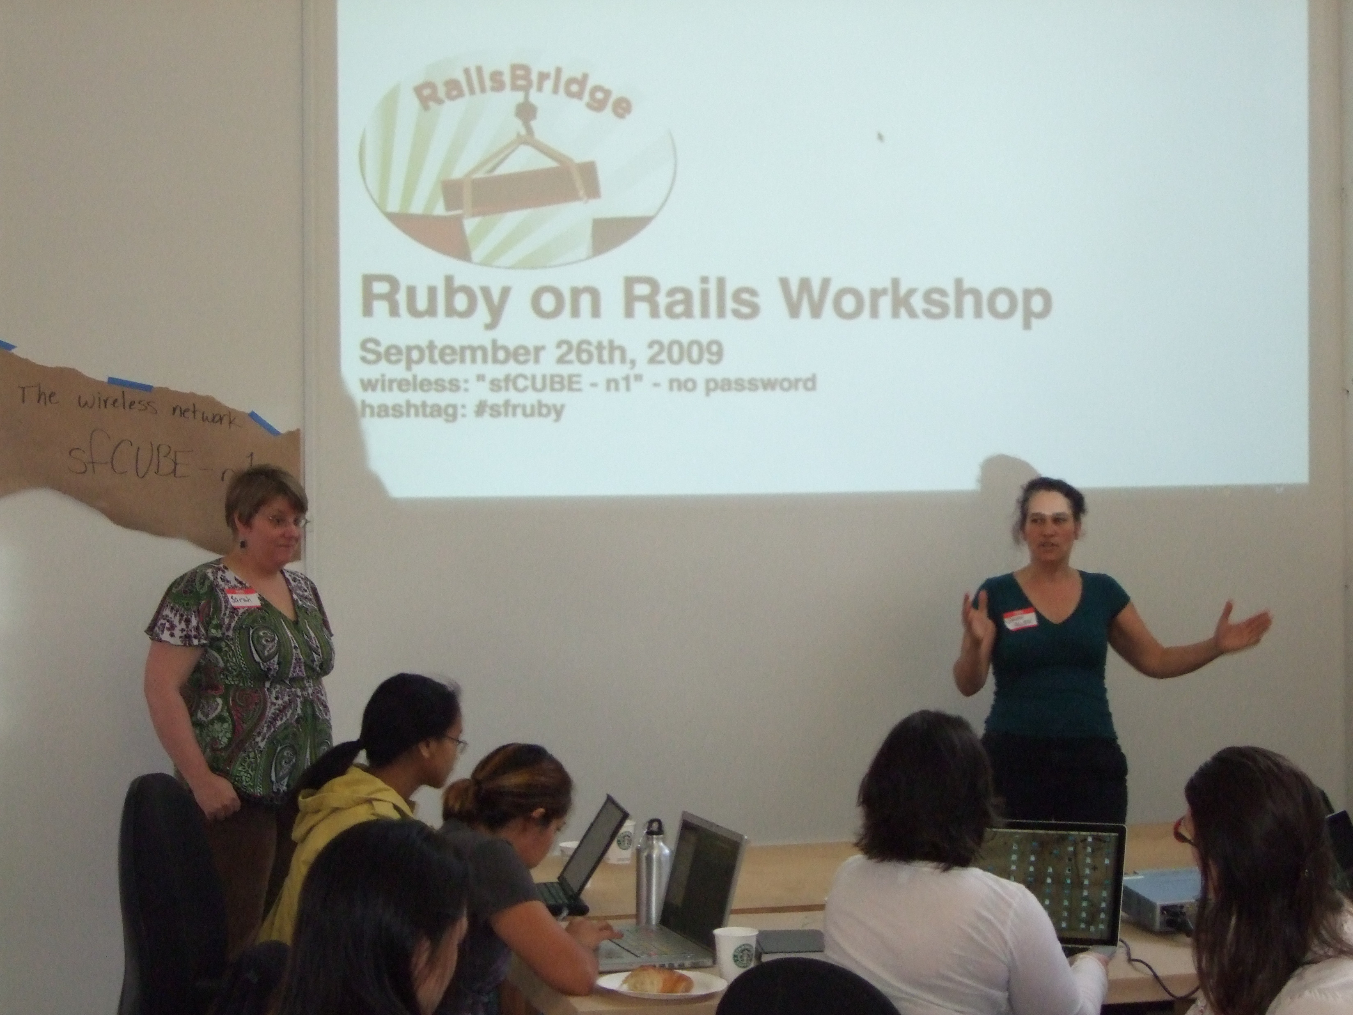

Slide 24
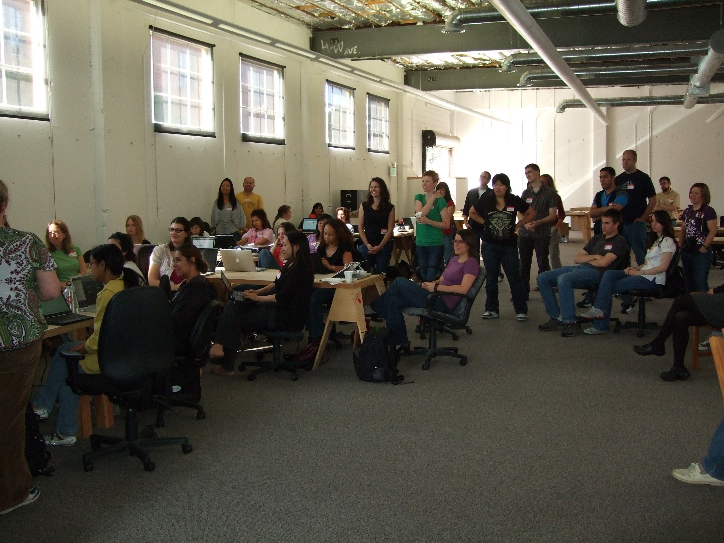

Slide 25
Short version: it was a lot of work.

Slide 26
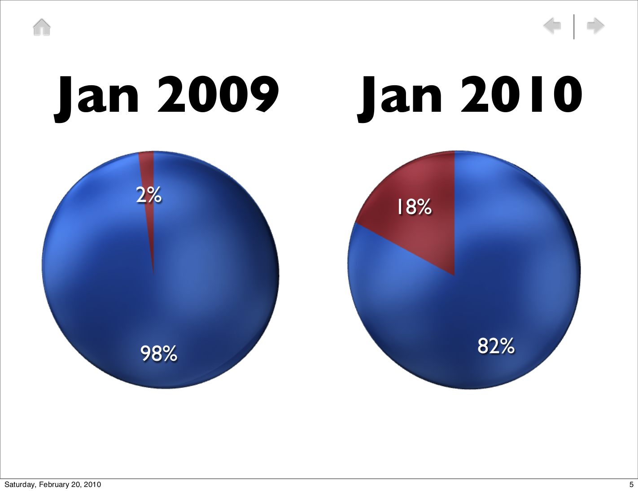

Slide 27
!

Slide 29
?

Slide 30
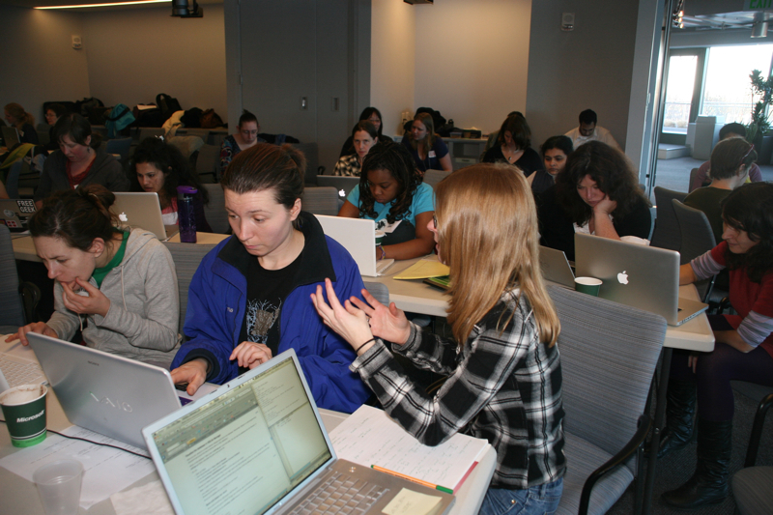

Slide 31
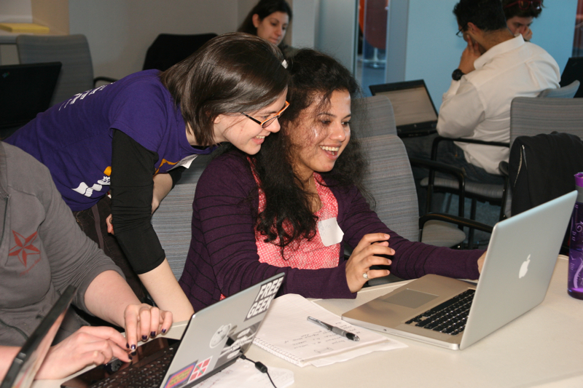

Slide 32
People are waiting on the sidelines

Slide 33
<4>
“Do”s and “Don't”s

Slide 34
Do:
Decrease latency

Slide 35
Do:
Decrease latency
(and terror)

Slide 36
for shy
people

Slide 37
-mentors

Slide 38
-mentors
Sep 2010
280 messages
26 unanswered

Slide 39
-mentors
Oct 2010
“Four days” goal

Slide 40
-mentors
Nov 2010
600 messages
3 unanswered

Slide 41
-mentors
Dec 2010
500 messages
7 unanswered

Slide 42
-mentors
“Four days” project
Messages +200%
Unanswered -90%

Slide 43
Do:
Set goals

Slide 44
Do:
Tell people
what to do

Slide 45
I want to help with Python in Debian

Slide 46
I want to help with Python in Debian
  Looka here: http://wiki.debian.org/Teams/ PythonModulesTeam

Slide 47
I want to help with Python in Debian
  Looka here: http://wiki.debian.org/Teams/ PythonModulesTeam
    I’ve already seen that page but didn’t find any specific tasks.

Slide 48
(then I told Andrey to work on expo.debian.net)

Slide 49
Do:
Attach people to
strong communities

Slide 50
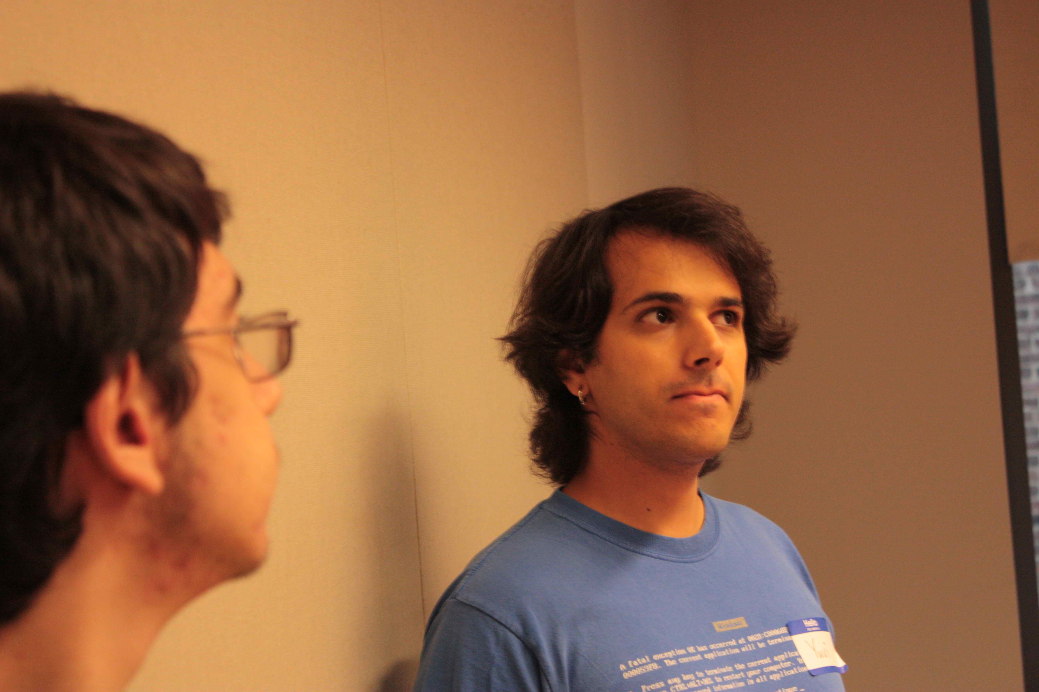

Slide 51
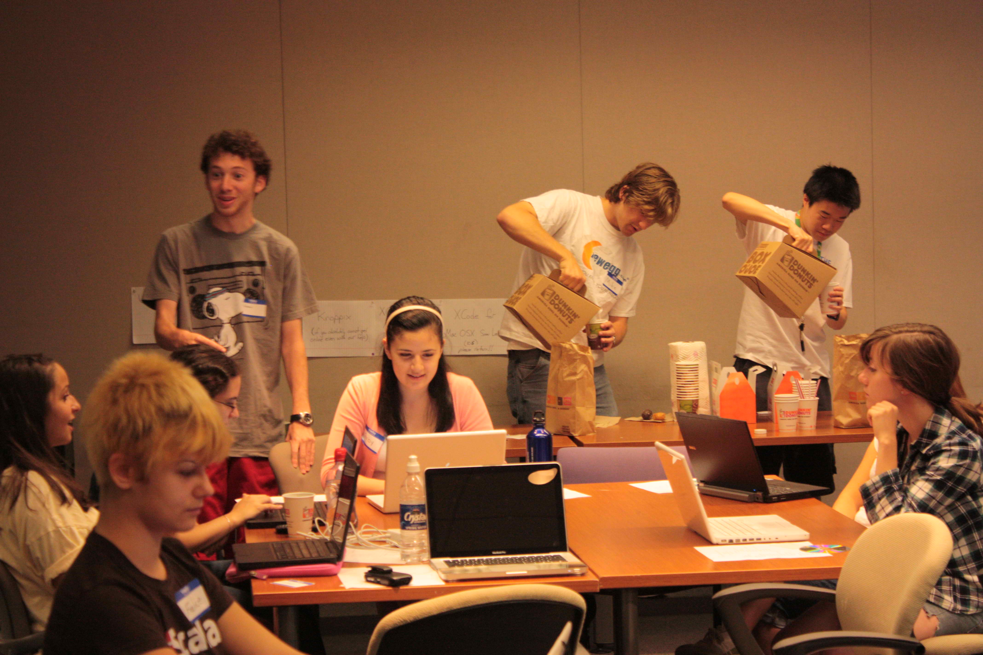

Slide 52
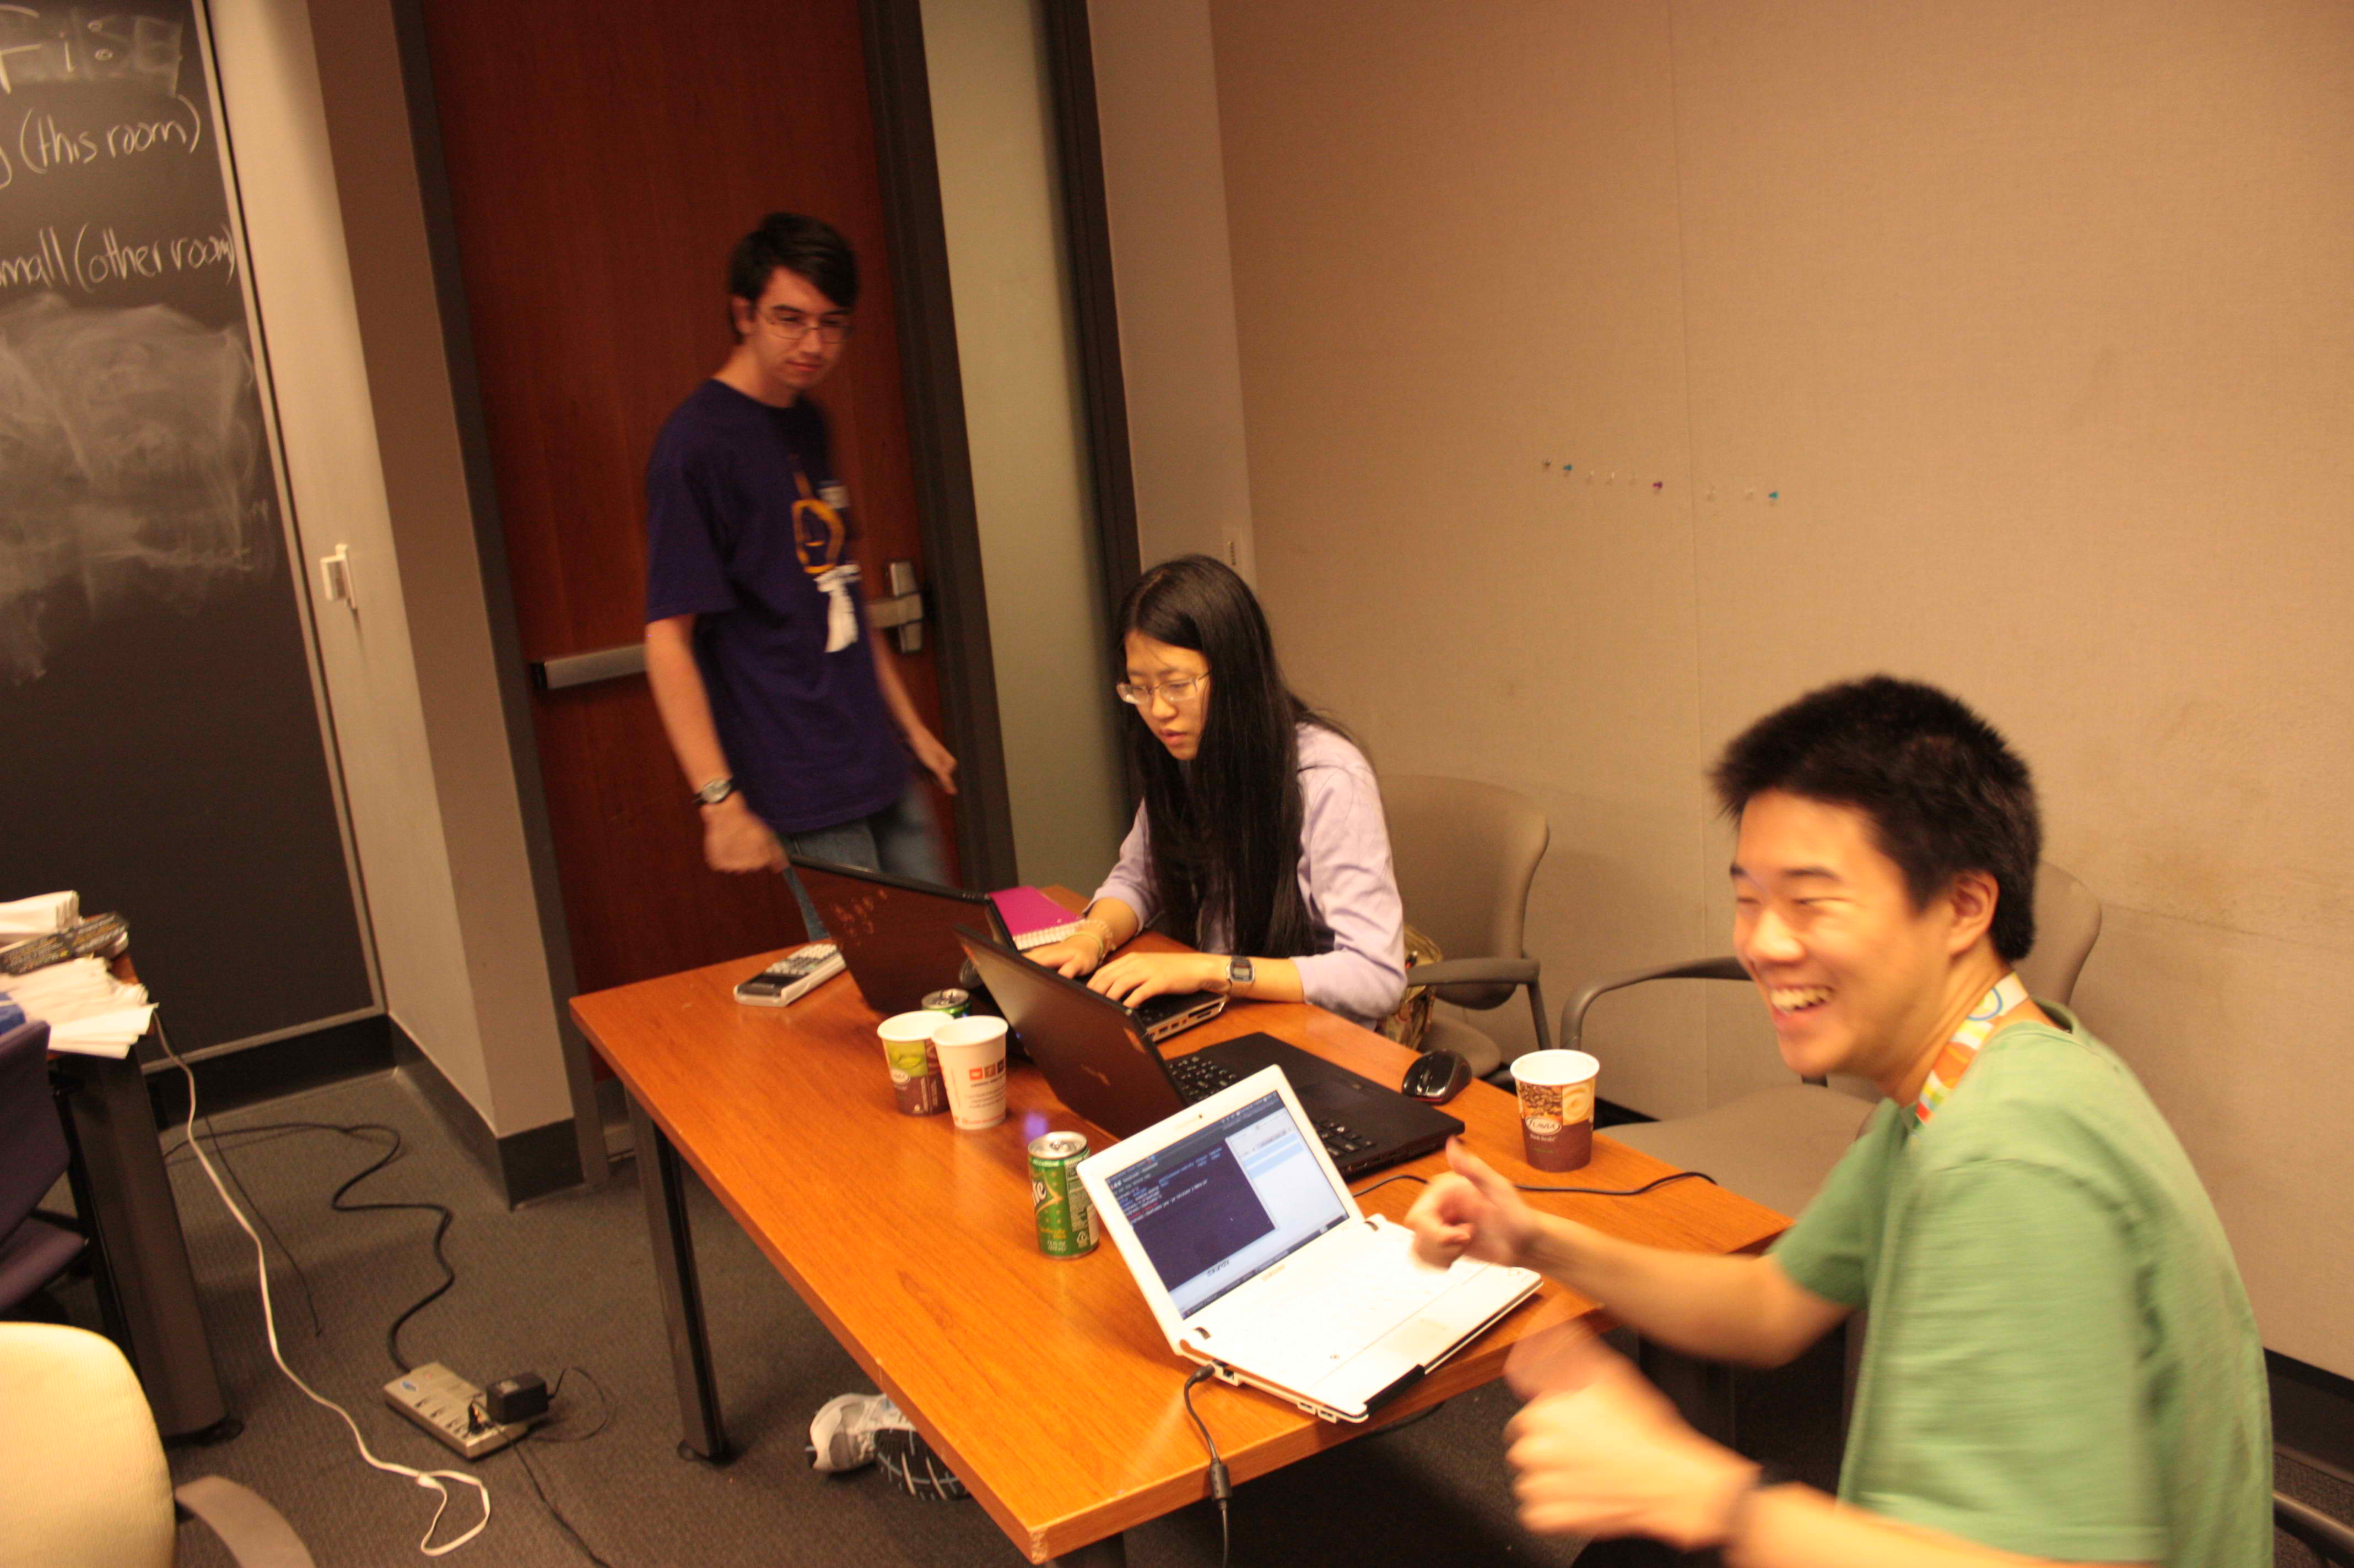

Slide 53
Do:
Attach people to
strong communities

Slide 54
Don't:
Isolate people to one project+mentor

Slide 55
Do:
One-on-one interviews

Slide 56
Don't:
Talk about how much you hate doing x

Slide 57
<5>
Credits

Slide 58
Thanks to
Máirín Duffy for photos in Fedora section
Tracy from the Boston Python Meetup
Sarah Allen for her slides
Wolfram Arnold from the SF Ruby Meetup

Slide 59
<6>
Conclusions

Slide 60
Demographics
reinforce themselves

Slide 61
Consider the
biases in your
outreach

Slide 62
Exploit the
biases in your
outreach

Slide 63
<7>
Next steps for you

Slide 64
All it takes is effort

Slide 65
Run a meetup outreach event
Run a Starling Bounty for your project, or help others with theirs
Put your project on OpenHatch
Ask me for help
http://asheesh.org/pycon11

